Slide 1
Integrative Project – Gravity and Orbits
By: Steven, Obaidah, Fang, and Angela
(Team SOFA)

Slide 2


Table of Contents
Project Objectives
Concept
Workflow behind Application Logic
Needs Addressed
Developed Functionalities
Challenges and Solutions
Lessons Learned

Slide 3


Project Objectives
This integrative project aims at developing a JavaFX application that implements one or more scientific concept(s) in physics, chemistry, mathematics, or a combination of those into a user-friendly program. It involves a data source from which information is pulled out, data flow systems, and the display of information to the user in an orderly fashion.

Slide 4

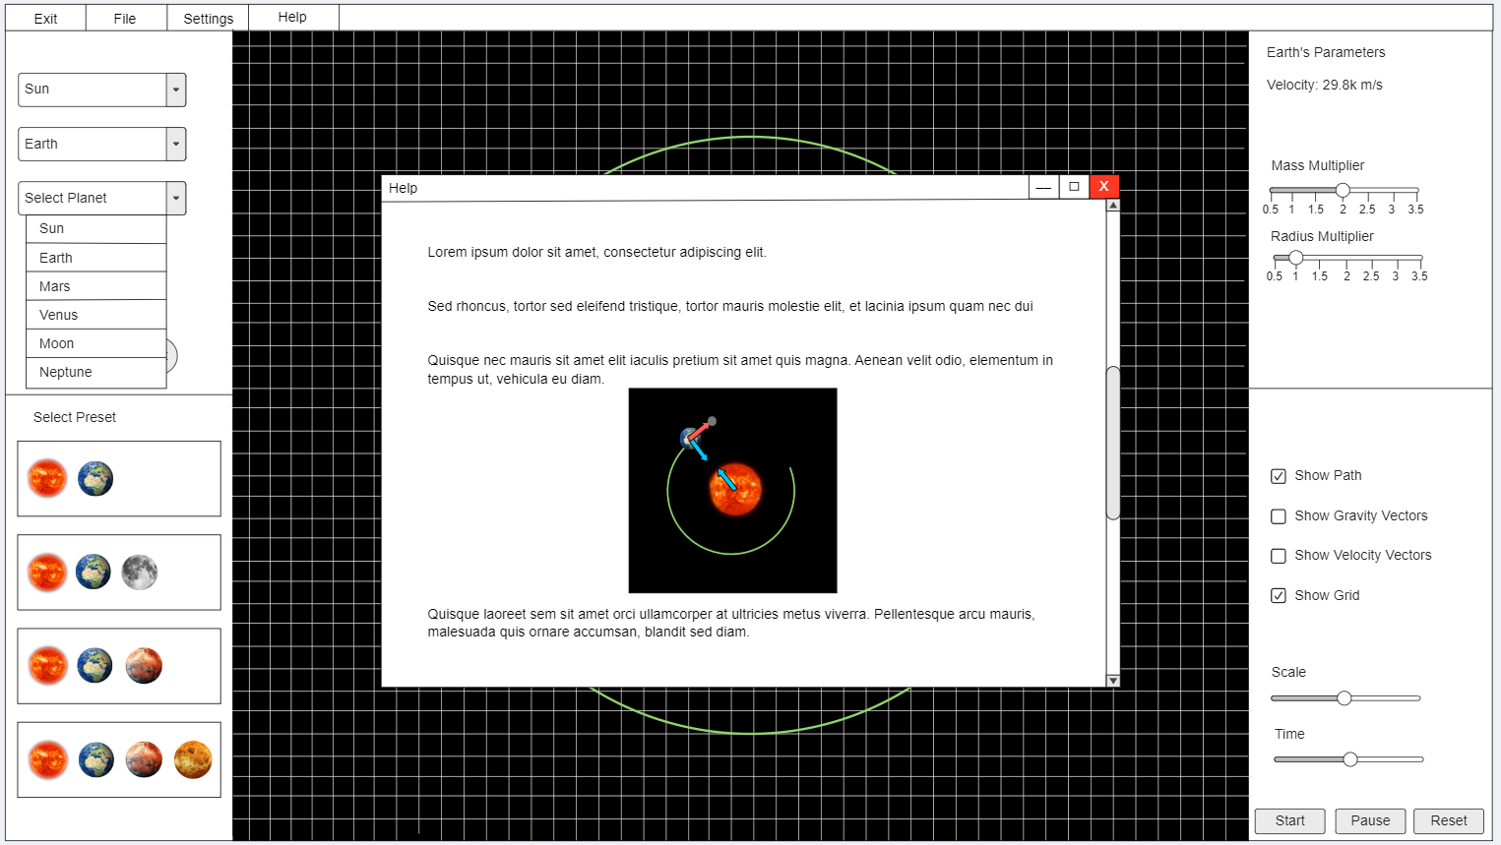
Concept
Our team’s concept: Gravity and Orbits simulator, an application that displays the animation of planets and how they are affected by gravitational forces.

Slide 5
Workflow behind Application Logic
Take input from the user (e.g., select planet, change language, etc.)
Pass data to appropriate method(s) and perform necessary calculations/logic (e.g., calculate the acceleration of selected planet)
Display rendering/animation of planets according to logic
User can interact with objects, menus, and options (e.g., move planets around, pause animation, etc.)
Handle exceptions and errors

Slide 6

Needs Addressed
This project addresses the following needs:
Allows user to visualize gravitational forces
Gives an idea of how physical and mathematical concepts play into the real world
Enables the user to interact with planets and modify their parameters, which would facilitate his/her understanding of these concepts

Slide 7

Developed Functionalities
These include the developed functionalities:
Login feature for security
Accept different kinds of input from the user (button clicks, entering numerical values, etc.)
Show an animation according to the user’s input
Settings menu, including changing the application’s language and theme

Slide 8


Challenges and Solutions
Along the way, there were many challenges that were met. They include:
Unavailability of team members to work in person
Mismanagement of time
Overall stress
Fortunately, solutions were found for these problems:
Constant online coordination to ensure progress
Referral to previous projects and documentation
Variable by member; team motivation

Slide 9

Lessons Learned
The team members were able to acquire experience and skills that will help them in their careers. Some lessons that were learned include the following:
Always coordinate and keep the team informed of what tasks to focus on, giving updates all the time.
Ask others for help when needed; there is no shame in that.
Deal with stress; do not avoid it.

Slide 10
Thank you for listening

